Slide 1
Python Course for Physicists (And everyone else!) Chunk 11: Reading and Writing Files
By Jonathan Bollig
10.10.2025
Notes:
Motivation: Data from measuring devices e.g. oscilloscopes, cameras, temperature sensors etc.

Slide 2
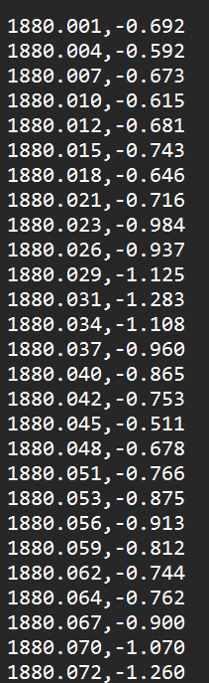



Focus: Delimiter Separated Values (e.g. csv)
“Normal” way: → Slow → No conversion to numpy data
Better way, works 90 % of time: → Lot of helpful options → Generates a numpy array → BUT: does not allow “,” as a decimal separator: ❌ 3,1415
Solution: Pandas
[https://www.spiegel.de/wissenschaft/natur/iucn-ueber-pandabaeren -gefaehrdet-statt-stark-gefaehrdet-a-1110974.html]

Slide 3

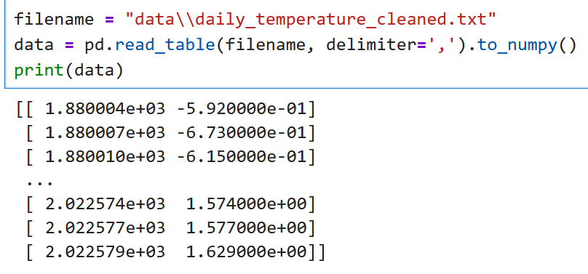
Pandas
Library for tabular data (built on top of numpy)
Can be very useful, but out of scope for this course
We only use it for reading data
Install in Anaconda Powershell Prompt: conda install pandas
To read a table:

Slide 4

Relative and Absolute Paths
Path: String that specifies a file / directory location:
Absolute Path: Path from “the bottom”: C:\2025 Python Course\Task Sheets\data\oscilloscope.csv
Current Working Directory (cwd)
cwd: The file path where your code is executed: Usually the parent folder of your executed file: C:\2025 Python Course\Task Sheets\
Find out the cwd:
Relative Path: Path relative to the current working directory: data\oscilloscope.csv
File names can be given as a relative or absolute path.
Careful: “\” is an escape sequence in a string → use “\\” instead.

Slide 5
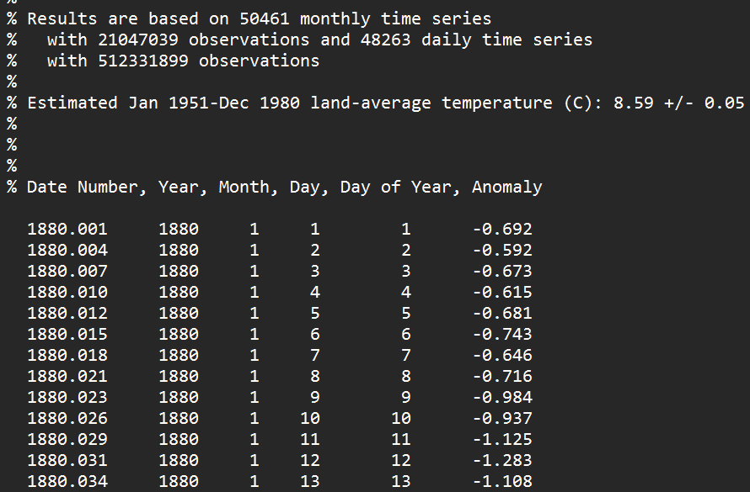
Live Coding: The Try and Error of File Loading
Data is often “dirty”:
Weird formats
Missing values
More data than we need
Headers and footers
Much more stuff, that messes it up
→ Usually, a try and error process: → No universal method ☹

Slide 6

File Saving
Human readable: Easy with numpy:
Only machine readable: → Faster → Error proof

Slide 7
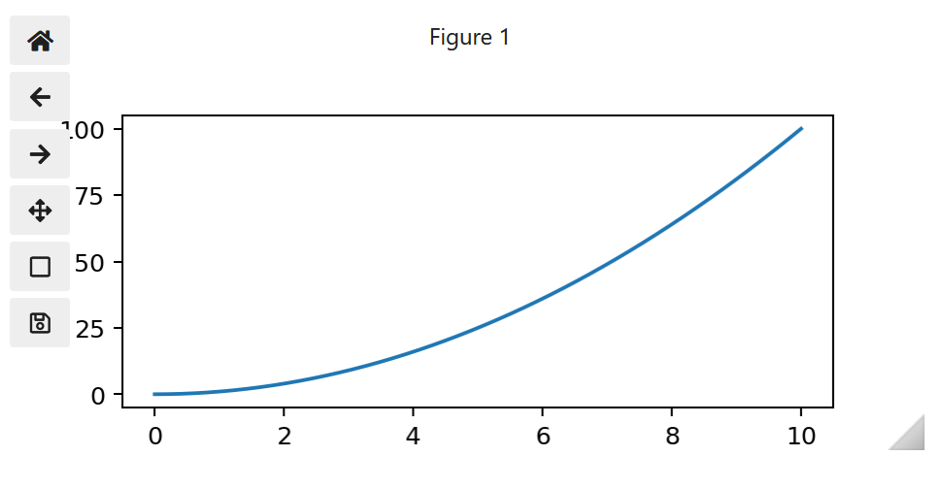

Extra Tip: Interactive Matplotlib
Matplotlib can be made interactive:
For this: conda install ipympl
Before importing: %matplotlib widget:

Slide 8

Good Luck with your Tasks ☺
[https://python.plainenglish.io/20-funny-programming-memes-that-will-make-your-day-5793a8e1608b]

